Slide 1

guess the word game

Slide 2
FROM OUR TEAM (HELLO WORLD)

Slide 3

What Is Idea Of Our Game

Slide 4

How we render the picture

Slide 5
And this some scenes from the game

Slide 6
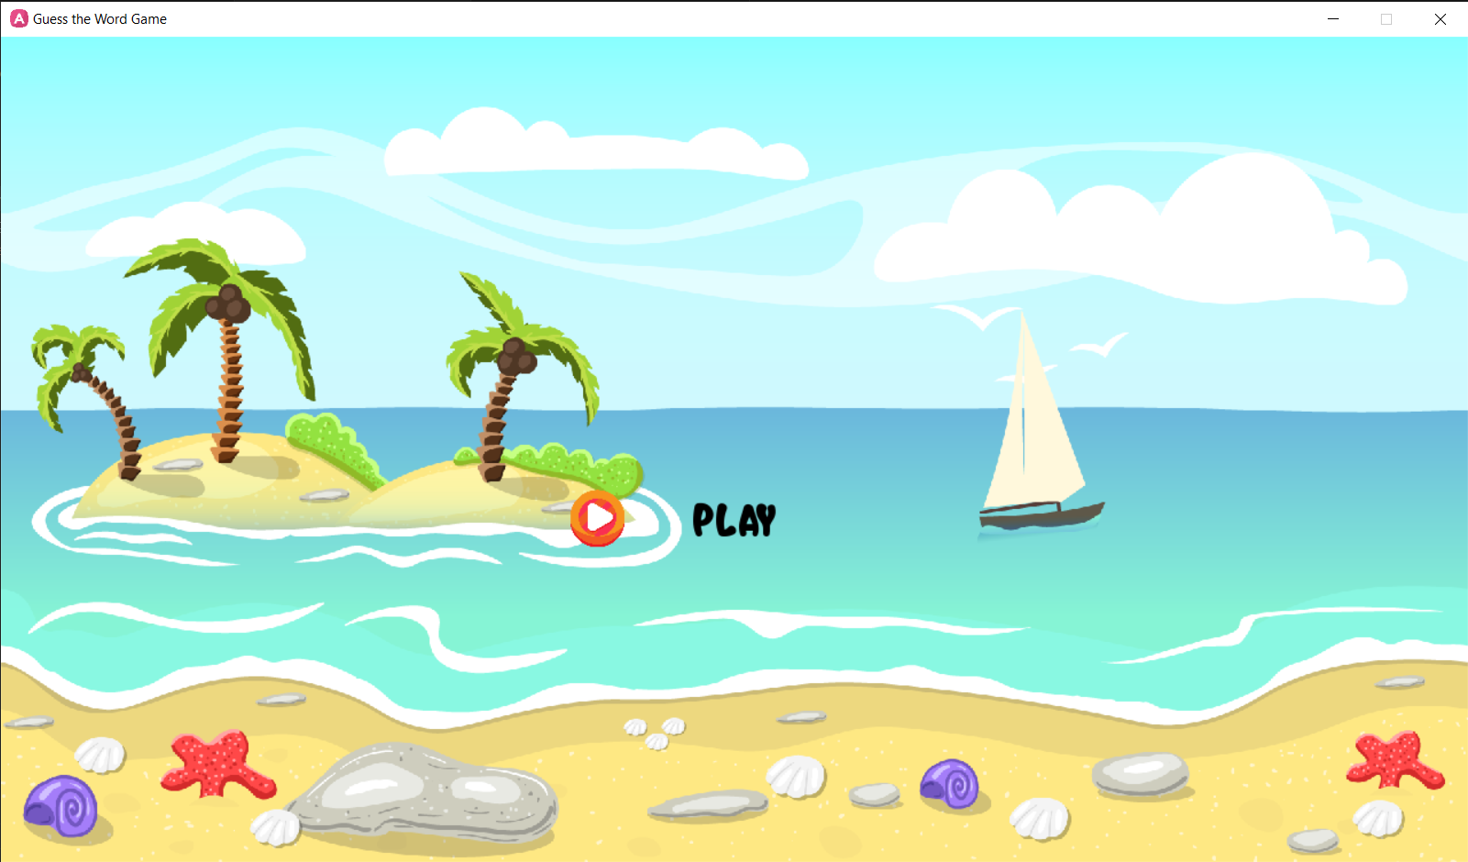

Slide 7
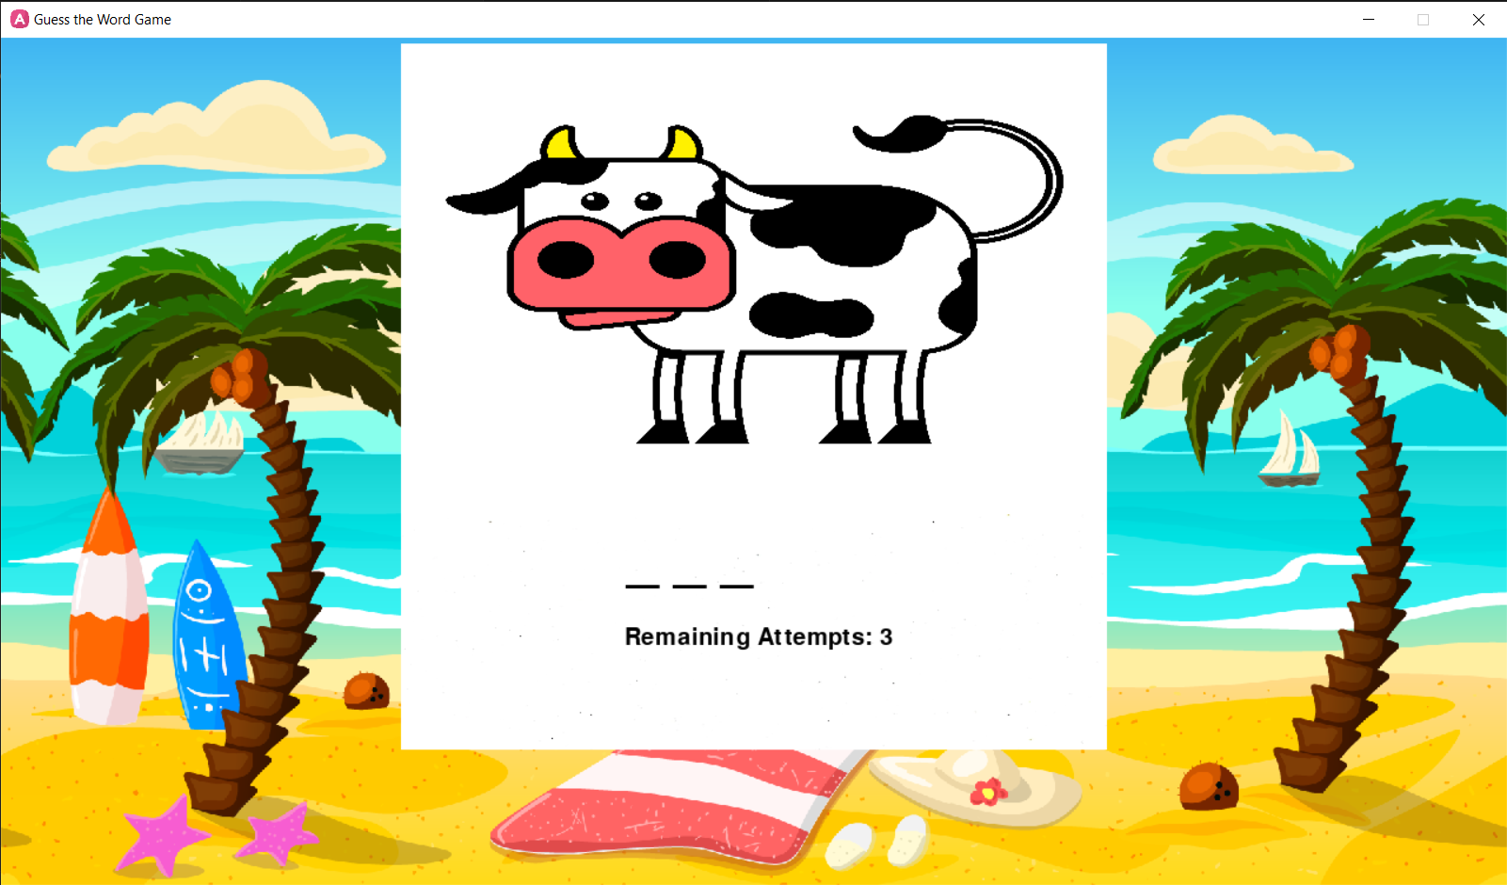

Slide 8


Slide 9


Slide 10


Slide 11
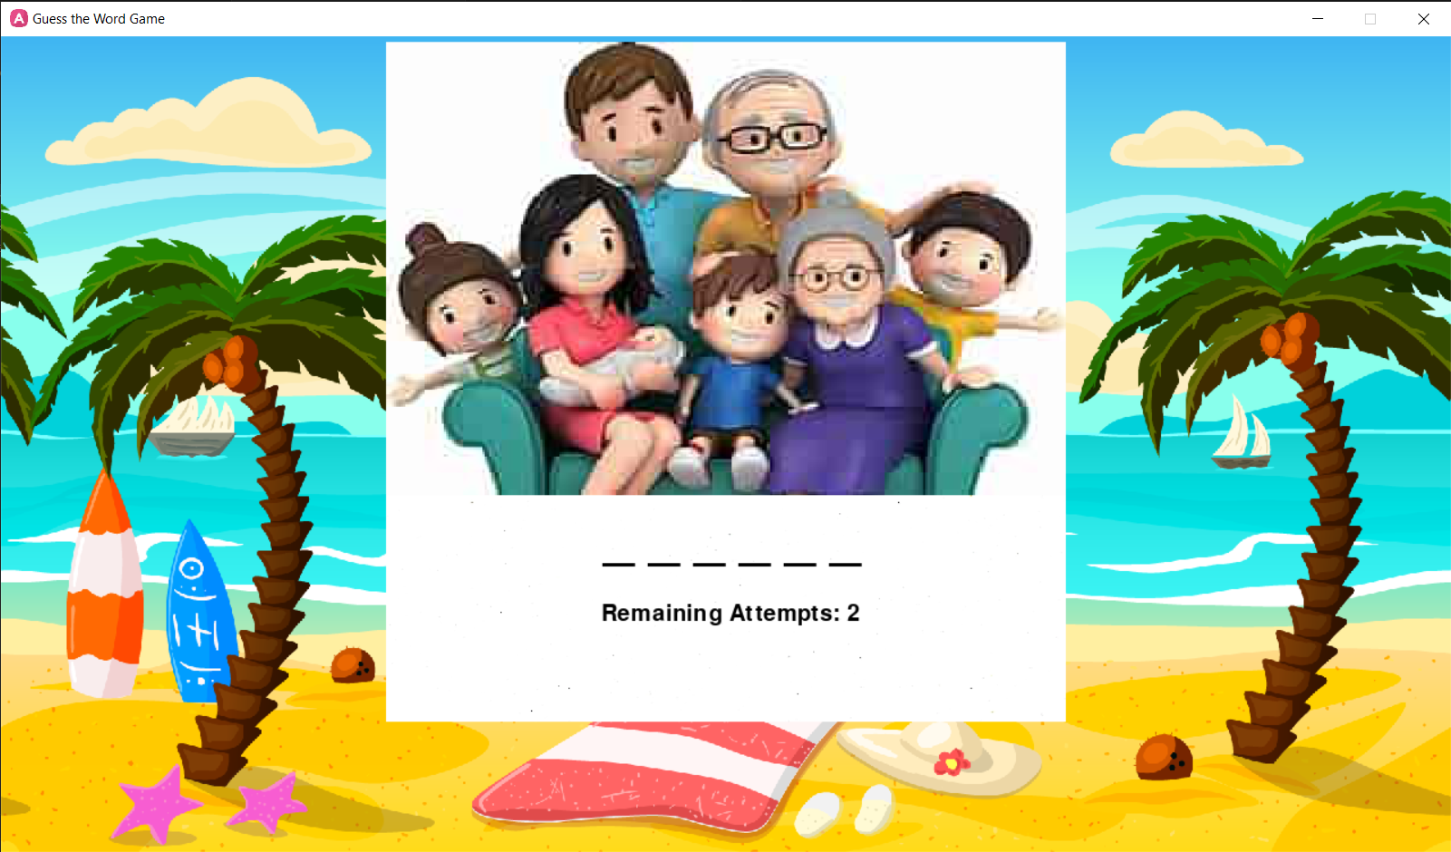

Slide 12
And from the cod that is coming we will know how we made the game

Slide 13
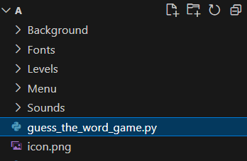

Slide 14
From the above picture you must know
That the folder hold our game
Cod and assest

Slide 15
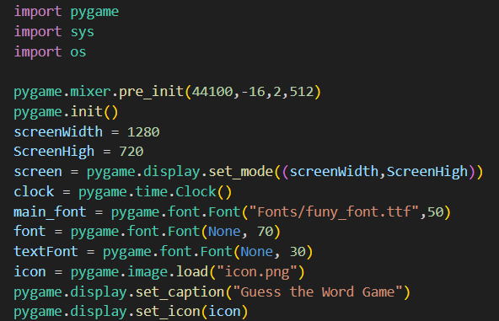

Slide 16
Her we import pygame library and some moduels
Under it we initilaize the the pygame
Then we set screen the frame rate of our game
And apendd font
And set the name
And set icon

Slide 17
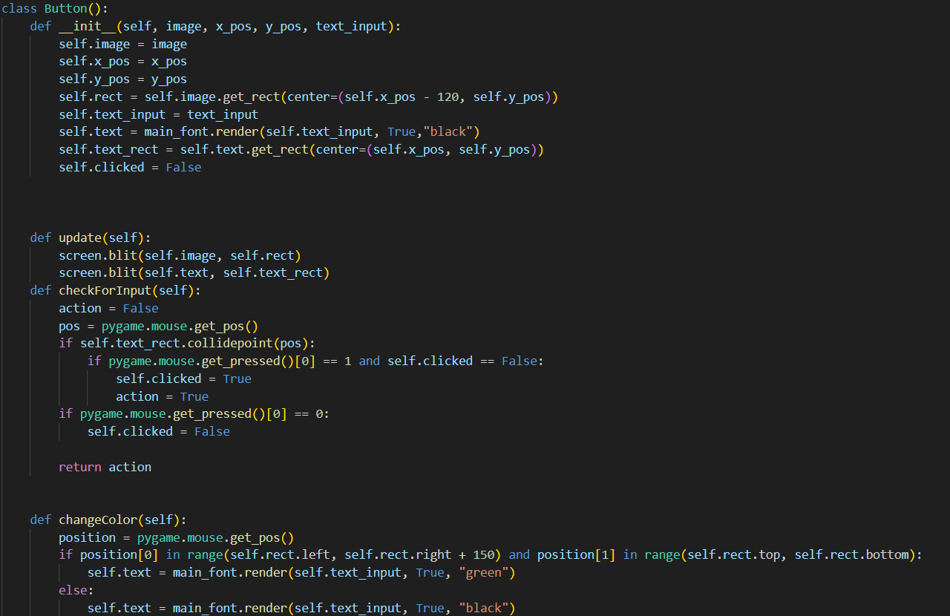

Slide 18
Her we have button class that allow us to make
Buttons and take input from it and hover rendering

Slide 19
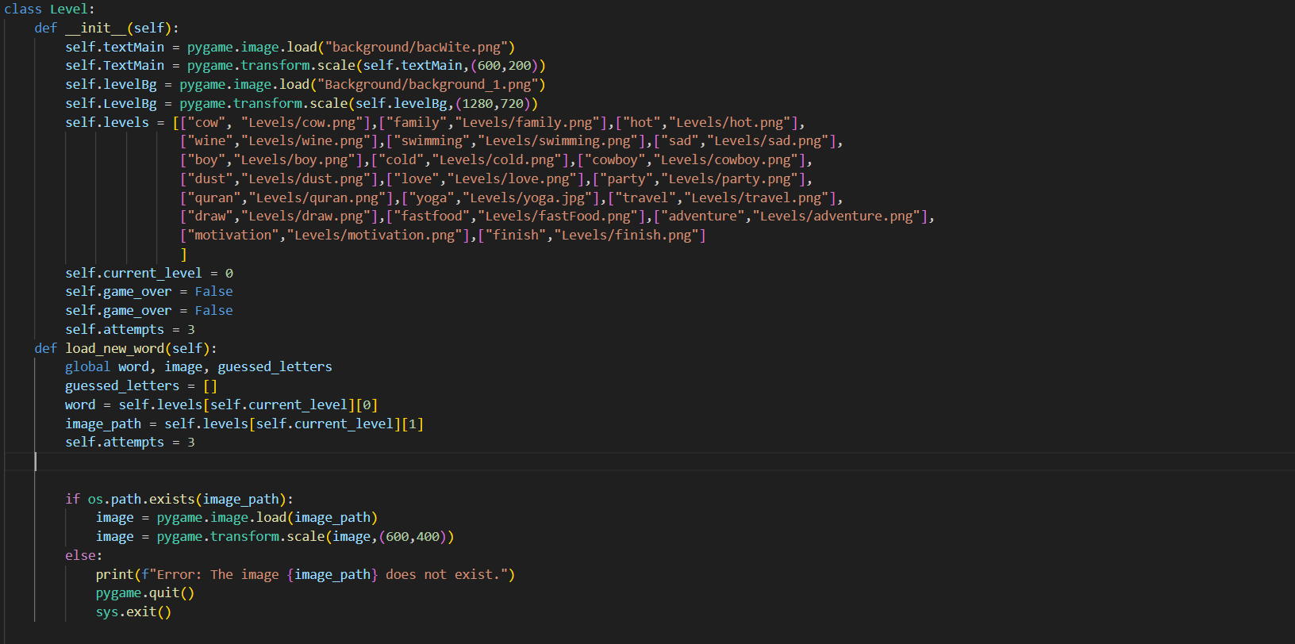

Slide 20
Her we have class level that have own level loop that allow
Us to render our levels component
And set the level

Slide 21
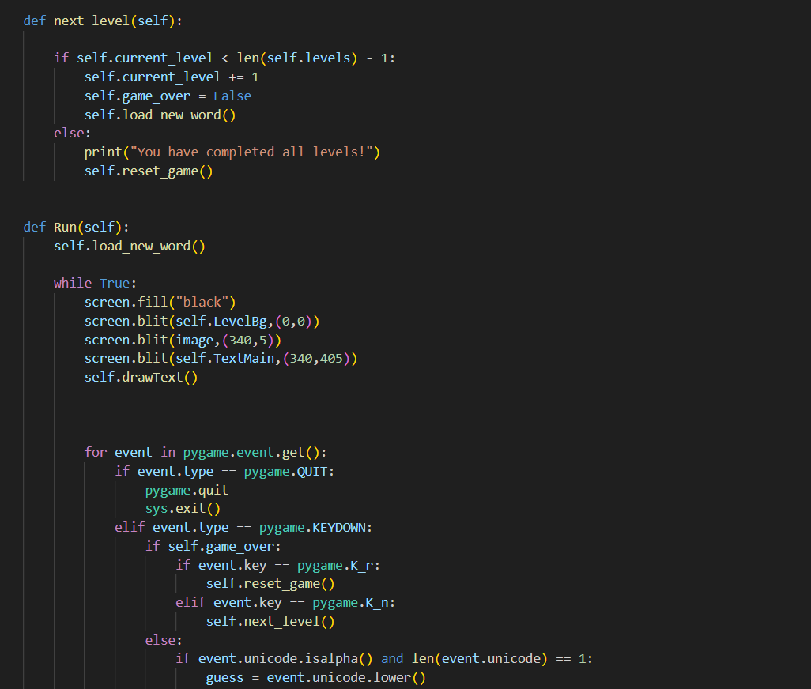
Her we have the other level class cmponent

Slide 22
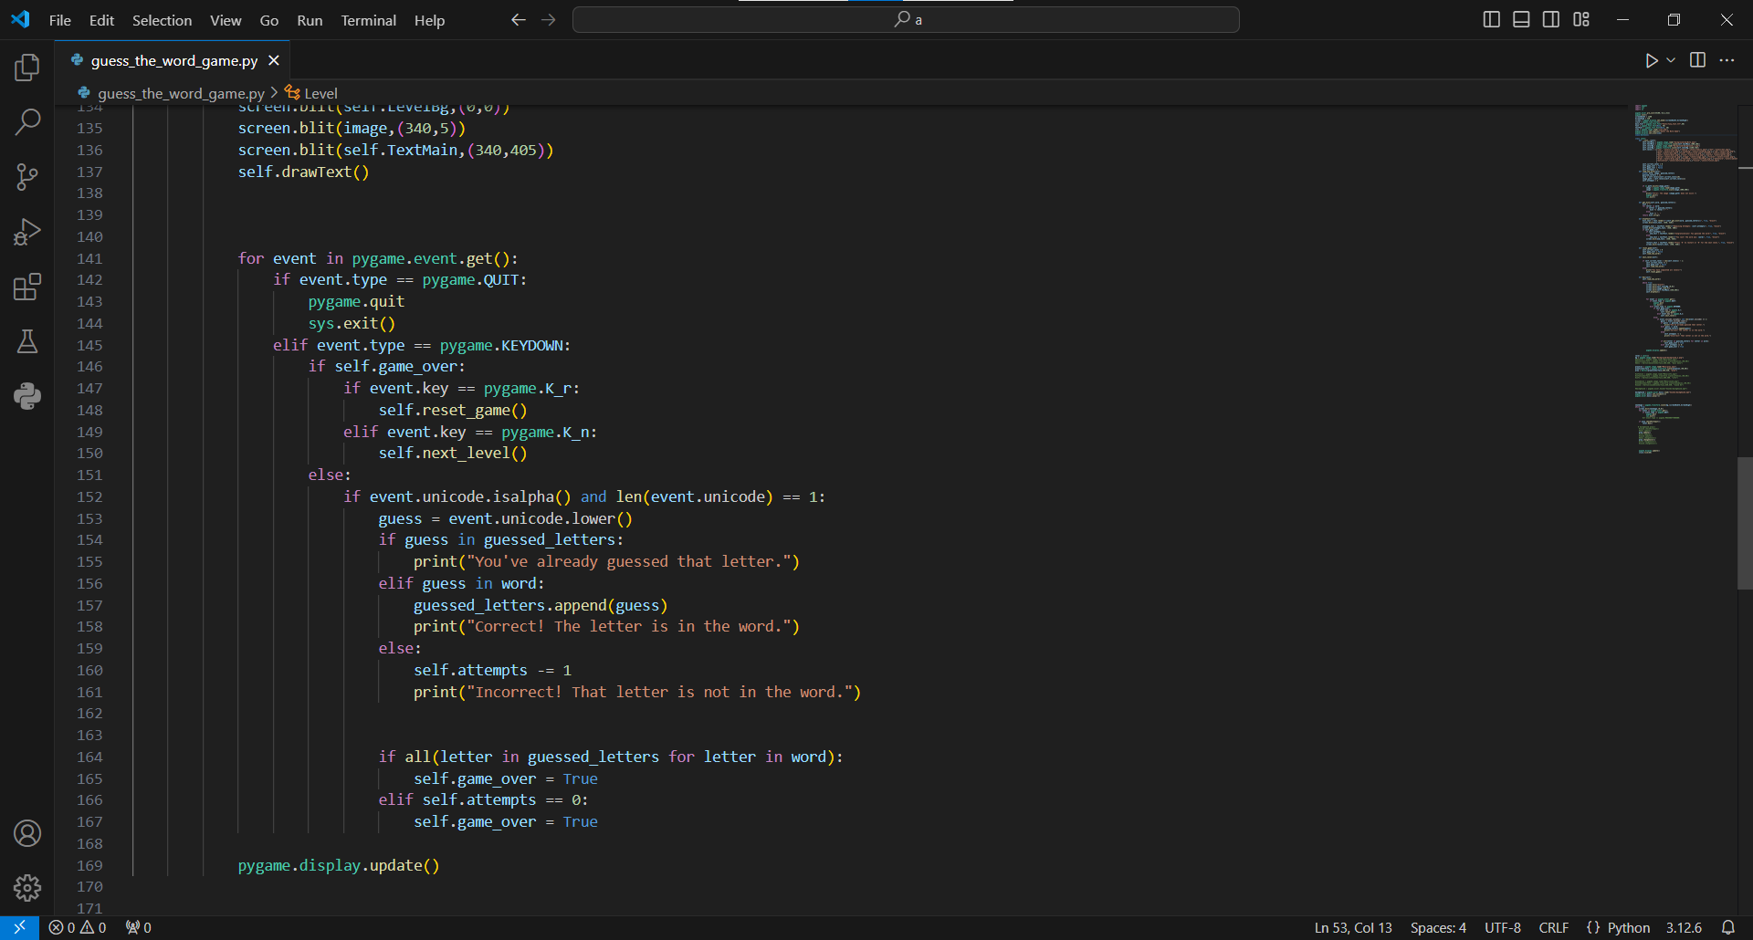

Slide 23
And her the main loop that display our main screen and tacke us to the level loop

Slide 24
